Slide 1
CS312 Artificial Intelligence
Lecture # 10
HITEC University, Taxila
Mr. Mubashir Iqbal
Fall-2025

Slide 2
Lecture Content
Data Splitting
Introduction to ML (ML):
  • Types of ML: Supervised, Unsupervised, Reinforcement Learning
  • Regression (Linear and Logistic)
  • Classification Techniques
  • Model Evaluation Metrics (Accuracy, Precision, Recall, F1-Score)
  • Hyperparameter Tuning and Overfitting

Slide 3
Data Splitting

Slide 4
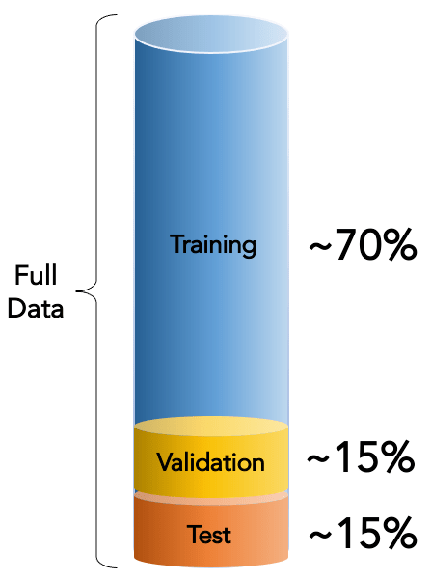
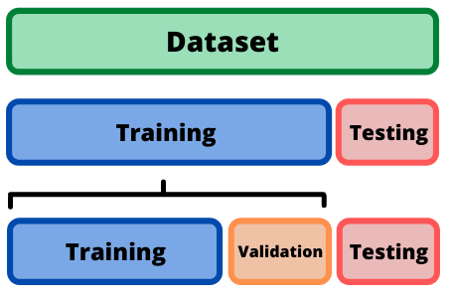
Data Splitting
Data splitting divides a dataset into parts to train, validate, and test artificial intelligence models. It ensures that the model is evaluated on unseen data, preventing overfitting and improving its generalization.

Slide 5
Data Splitting
The dataset is commonly divided into three parts:
Training Data: Typically, 60-70% of the dataset.
Validation Data: Used to tune hyperparameters and evaluate the model during training. 10-20% of the dataset.
Testing Data: Used for the final evaluation of the model after training. 20-30% of the dataset.
Example Ratios:
60-20-20: Training (60%), Validation (20%), Testing (20%)
70-15-15: Training (70%), Validation (15%), Testing (15%)
80-20: Training (80%), Testing (20%)

Slide 6
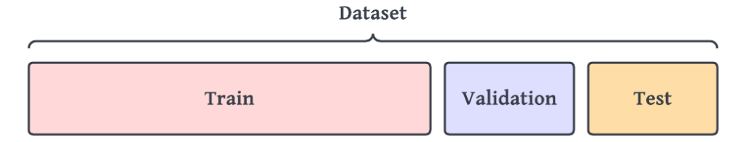
Data Splitting
from sklearn.model_selection import train_test_split
# Convert to DataFrame
df = pd.DataFrame(data)
# Split the data into features (X) and target labels (y)
X = df[['Feature1', 'Feature2’]]
y = df['Label’]
# Randomly split into training (70%), validation (15%), and testing (15%)
X_train, X_temp, y_train, y_temp = train_test_split(X, y, test_size=0.3, random_state=42)
X_val, X_test, y_val, y_test = train_test_split(X_temp, y_temp, test_size=0.5, random_state=42)

Slide 7
Why Do We Need Data Splitting?
Avoid Overfitting: Without splitting, the model might memorize the dataset instead of learning patterns, leading to poor performance on new data
Model Evaluation: Splitting allows us to test the model on unseen data, giving a realistic measure of its accuracy and robustness
Hyperparameter Tuning: Validation data helps optimize model parameters without affecting the testing results.

Slide 8
Techniques for Data Splitting
Random Splitting: Randomly split data into training, validation, and testing subsets.
Stratified Splitting: Ensures the class distribution remains consistent across all subsets (important for imbalanced datasets).
K-Fold Cross-Validation: The dataset is split into K parts (folds). Each fold is used as a test set once, while the remaining folds are used for training
train_test_split(X, y, test_size=0.3, random_state=42)
train_test_split(X, y, test_size=0.3, stratify=y, random_state=42)
from sklearn.model_selection import Kfold
…….
…….
…….

Slide 9
Introduction to
Artificial Intelligence

Slide 10
Artificial Intelligence (AI)
A field of computer science that focuses on creating systems that can perform tasks that would normally require human intelligence.
These tasks include understanding language, pattern recognition, making decisions, and solving problems.
AI aims to build machines or programs that can think, learn, and adapt to new situations, making it possible for computers to mimic human abilities and cognitive function.

Slide 11
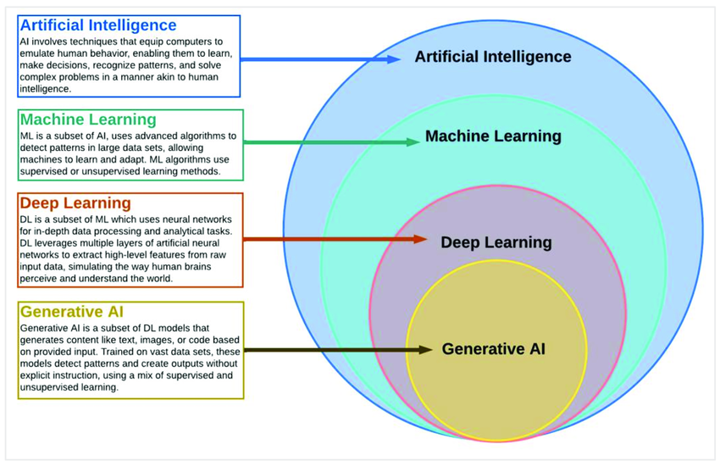

Slide 12
Key Branches of AI
1. Machine Learning (ML)
  Use Case: Learn patterns from data to make predictions or decisions.
  Real-World Example: Gmail’s spam email detection.
2. Deep Learning (DL)
  Use Case: Automatically extract features from large datasets using neural networks.
  Real-World Example: Face recognition in smartphones.
3. Natural Language Processing (NLP)
  Use Case: Understand and generate human language.
  Real-World Example: ChatGPT answering questions.
4. Computer Vision
  Use Case: Enable machines to interpret and analyze images or video.
  Real-World Example: Self-driving cars detecting pedestrians.

Slide 13
Key Branches of AI
5. Robotics
  Use Case: Build intelligent machines that can act and interact with the physical world.
  Real-World Example: Warehouse robots used by Amazon for item picking.
6. Expert Systems
  Use Case: Use a knowledge base and rules to make expert-level decisions.
  Real-World Example: Medical diagnosis systems that suggest treatment options.
7. Reinforcement Learning
  Use Case: Learn actions by trial and error to maximize reward.
  Real-World Example: AlphaGo learning to defeat world champion Go players.
8. Fuzzy Logic
  Use Case: Make decisions in situations with uncertainty or imprecise data.
  Real-World Example: Washing machines adjusting wash cycles based on dirt levels.

Slide 14
Key Branches of AI
9. Evolutionary Computation (Genetic Algorithms)
  Use Case: Optimize solutions using natural selection principles.
  Real-World Example: Designing aerodynamic shapes for aircraft wings.
10. Speech Recognition
  Use Case: Convert spoken words into text.
  Real-World Example: Siri or Google Assistant understanding voice commands.
11. Planning & Reasoning (Automated Planning)
  Use Case: Allow AI to plan sequences of actions to reach a goal.
  Real-World Example: NASA’s autonomous rover planning paths on Mars
12. Knowledge Representation & Ontology
  Use Case: Store and organize knowledge in a machine-understandable form.
  Real-World Example: Semantic web (Google Knowledge Graph).

Slide 15
Introduction to ML

Slide 16
Machine Learning
Definition: Machine Learning (ML) is a subfield of Artificial Intelligence (AI) that focuses on developing systems that can learn patterns from data and improve their performance over time without being explicitly programmed.
Instead of writing fixed rules (as in traditional programming), ML algorithms automatically infer rules, relationships, and predictions by analyzing examples.
Explicitly programmed means the computer is given exact, step-by-step instructions written by a human.

Slide 17
Machine Learning
Key Characteristics of Machine Learning
  Data-driven (performance improves with more data)
  Self-adaptive (learns from feedback)
  Model-based (mathematical functions)
  Probabilistic and statistical foundation
  Generalizes to unseen data
Core Idea of Machine Learning
  ML works by mapping input features to output predictions, using mathematical models.
Example:
  Input: Age, Salary, Shopping history
  Output: Likelihood of purchasing a product
  The ML model learns this mapping from past labeled examples.

Slide 18
Machine Learning
ML algorithms are classified into three main types based on how they learn from the data:
  Supervised Learning
  Unsupervised Learning
  Reinforcement Learning.

Slide 19
1. Supervised Learning
Supervised Learning is when a model learns from labeled data, meaning the correct answers are already provided. The model simply learns the pattern between input and output.
Example: You give images of cats and dogs with labels, and the model learns to identify them.
The goal is to learn a mapping from inputs to outputs so that the model can predict the label for new, unseen data
Used for: Classification (categorizing data) and regression (predicting continuous values).

Slide 20
Algorithms of Supervised Learning
1. Linear Regression
  Use Case: Predict continuous numerical values.
  Example: Predicting house prices using area, rooms, and location.
2. Logistic Regression
  Use Case: Binary classification (yes/no, true/false).
  Example: Detecting whether an email is spam or not.
3. K-Nearest Neighbors (KNN)
  Use Case: Classify an object based on the closest data points.
  Example: Classifying a new flower species based on similar flowers.
4. Support Vector Machine (SVM)
  Use Case: Find the best boundary that separates classes.
  Example: Classifying malignant vs. benign tumors in medical imaging.

Slide 21
Algorithms of Supervised Learning
5. Decision Tree
  Use Case: Classification using rule-based decision paths.
  Example: Deciding if a person will buy a product based on income, age, etc.
6. Random Forest
  Use Case: Improve accuracy by combining many decision trees.
  Example: Predicting loan approval more reliably in banks.
7. Naïve Bayes
  Use Case: Probabilistic classification using conditional probability.
  Example: Sentiment analysis (positive/negative reviews).
8. Gradient Boosting (XGBoost, LightGBM, AdaBoost)
  Use Case: High-performance prediction using boosting techniques.
  Example: Fraud detection in banking systems.

Slide 22
Summary
S/N | Algorithm | Category | One-line Use Case | Real-world Example
1 | Linear Regression | Regression | Predict continuous values | House price prediction
2 | Logistic Regression | Classification | Yes/No decisions | Spam detection
3 | KNN | Classification | Classify based on neighbors | Flower classification
4 | SVM | Classification | Best decision boundary | Cancer detection
5 | Decision Tree | Classification | Rule-based decisions | Customer purchase prediction
6 | Random Forest | Classification | Ensemble for high accuracy | Loan approval
7 | Naive Bayes | Classification | Probability-based decisions | Sentiment analysis
8 | Boosting Models | Both | High-performance learning | Fraud detection
9 | Neural Networks | Both | Learn complex patterns | Handwritten digit recognition

Slide 23
2. Unsupervised Learning
Unsupervised Learning is when a model learns from unlabeled data, no correct answers are given. The model tries to discover hidden patterns or groups on its own.
Example: Grouping customers into clusters based on their behavior (without knowing their categories before).
The model tries to identify patterns, groupings, or structures within the data on its own.
Unsupervised learning is often used for exploratory data analysis (EDA) and data segmentation.
Used for: Clustering (grouping similar data) and association (finding relationships in data).

Slide 24
Algorithms of Unsupervised Learning
1. K-Means Clustering
  Use Case: Group similar items into clusters.
  Example: Customer segmentation in marketing (grouping customers by buying behavior).
2. Hierarchical Clustering
  Use Case: Build a tree-like structure of clusters.
  Example: Creating gene/protein similarity trees in bioinformatics.
3. DBSCAN (Density-Based Clustering)
  Use Case: Detect clusters of any shape and identify noise/outliers.
  Example: Identifying unusual movement patterns in GPS tracking (outlier detection).
4. Gaussian Mixture Models (GMM)
  Use Case: Probabilistic clustering using mixture of Gaussian distributions
  Example: Speaker identification (different speaker voice patterns).

Slide 25
Algorithms of Unsupervised Learning
5. Principal Component Analysis (PCA)
  Use Case: Reduce high-dimensional data to lower dimensions while keeping important information.
  Example: Reducing image size/features for faster facial recognition.
6. Singular Value Decomposition (SVD)
  Use Case: Dimensionality reduction and matrix factorization.
  Example: Movie recommendation systems (Netflix, YouTube).
7. Apriori Algorithm
  Use Case: Discover frequent itemsets and association rules.
  Example: Market Basket Analysis (People who buy bread also buy butter).
8. Autoencoders (Neural Networks for Unsupervised Learning)
  Use Case: Learn compressed representations of data.
  Example: Removing noise from images (denoising autoencoders).

Slide 26
Summary
Algorithm | Category | One-line Use Case | Real-world Example
K-Means | Clustering | Group similar data | Customer segmentation
Hierarchical Clustering | Clustering | Build tree-like cluster structure | Gene clustering
DBSCAN | Clustering | Detect clusters + outliers | GPS anomaly detection
GMM | Clustering | Probabilistic cluster modeling | Speaker identification
PCA | Dimensionality Reduction | Reduce features | Facial recognition preprocessing
SVD | Dimensionality Reduction | Matrix factorization | Movie recommendations
Apriori | Association Rule Mining | Find co-occurring items | Market basket analysis
Autoencoders | Representation Learning | Learn compressed features | Image noise removal

Slide 27
3. Reinforcement Learning
Reinforcement Learning (RL) is a type of ML where an agent/model learns by interacting with an environment and receiving feedback through rewards or penalties. It learns the best actions by trial and error to maximize the reward.
Example: A robot learning to walk, or an AI learning to play a game by earning points.
The agent/model aims to maximize the cumulative reward over time by choosing the best actions.
RL is widely used in games, robotics, decision-making tasks, and sequential tasks.

Slide 28
Algorithms of Reinforcement Learning
1. Q-Learning
  Use Case: Learn the best action for each state using a Q-table.
  Real-World Example: A robot learning the shortest path in a maze.
2. Deep Q-Network (DQN)
  Use Case: Uses deep neural networks to handle large or continuous state spaces.
  Real-World Example: AI learning to play Atari games like Breakout and Space Invaders.
3. SARSA (State–Action–Reward–State–Action)
  Use Case: Learns a policy that includes the effect of the agent’s current behavior.
  Real-World Example: Autonomous navigation where actions depend on the agent’s current policy (safer training).
4. Monte Carlo Control
  Use Case: Learn optimal actions by averaging returns from complete episodes.
  Real-World Example: Game-playing agents like blackjack strategies in casinos.

Slide 29
Algorithms of Reinforcement Learning
5. Policy Gradient Methods
  Use Case: Directly optimize the policy instead of a value function.
  Real-World Example: Robotics actions like smooth arm movement control.
6. REINFORCE Algorithm
  Use Case: A basic policy gradient method that improves actions based on rewards from episodes.
  Real-World Example: Training an agent to choose ads that maximize user clicks.
7. Actor–Critic Methods
  Use Case: Combine policy learning (actor) and value estimation (critic) for stable training.
  Real-World Example: Real-time decision-making in smart energy grid systems.
9. PPO (Proximal Policy Optimization)
  Use Case: Maintains stable updates while improving policies, widely used in modern RL.
  Real-World Example: OpenAI used PPO to train robots and language-guided agents.

Slide 30
Regression & Classification

Slide 31
What is Regression Problem
A regression problem is a type of machine learning task where the goal is to predict a continuous (numerical) value based on input data. Regression is used when the output you want to predict is a number, not a category.
Examples
  1. Predicting House Price
    Input: size, location, number of rooms
    Output: Price in rupees → like 8,500,000 PKR
    This is a regression problem because the answer is a number.
  2. Predicting Temperature
    Input: humidity, wind speed, pressure
    Output: Temperature in °C
    Numerical value → regression.
  3. Predicting a Student’s Marks
    Input: study hours, attendance
    Output: Marks out of 100
    Again, numerical → regression.

Slide 32
What is Classification Problem
A classification problem is a type of machine learning task where the goal is to predict a category or class, not a number. Classification is used when the output you want to predict is a label, such as yes/no, spam/not spam, or disease/no disease.
Examples
  1. Predicting Whether a Student Will Pass or Fail
    Input: study hours, attendance
    Output: Pass or Fail
    Two classes → classification.
  2. Classifying Types of Flowers (e.g., Iris Dataset)
    Input: petal length, sepal width
    Output: Setosa, Versicolor, or Virginica
    Three classes → multi-class classification.
  3. Medical Diagnosis
    Input: symptoms, medical test values
    Output: Diabetic, Non-Diabetic
    Categories → classification.

Slide 33
Model Evaluation Metrics
(Accuracy, Precision, Recall, F1-Score)

Slide 34
List of Evaluation Metrics
Evaluation Matrix (Classification)
    Confusion Matrix
    Accuracy
    Recall
    Precision
    F1-Score
    ROC curve
  Evaluation Matrix (Regression)
      Mean Absolute Error (MAE)
      Mean Square Error (MSE)
      Root Mean Square Error (RMSE)
      Many more

Slide 35
Need of Evaluation
The evaluation process is the way to check how well a model or program works. This process uses different methods to see if the model’s predictions (what it thinks will happen) are close to the actual results.
Evaluating a model is important because it shows the model has learned useful patterns or just memorized the data. A good evaluation process helps to pick the best model, find any mistakes, and improve its performance.

Slide 36
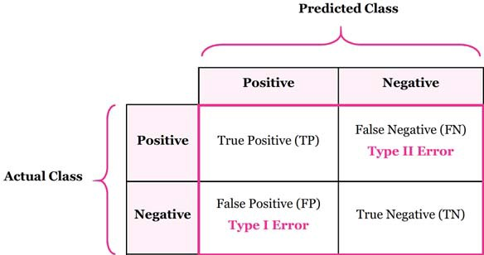
1. Confusion Matrix
A confusion matrix is a table that helps visualize the performance of a classification model.
The number of correct and incorrect predictions are summarized with count values and broken down by each class.

Slide 37
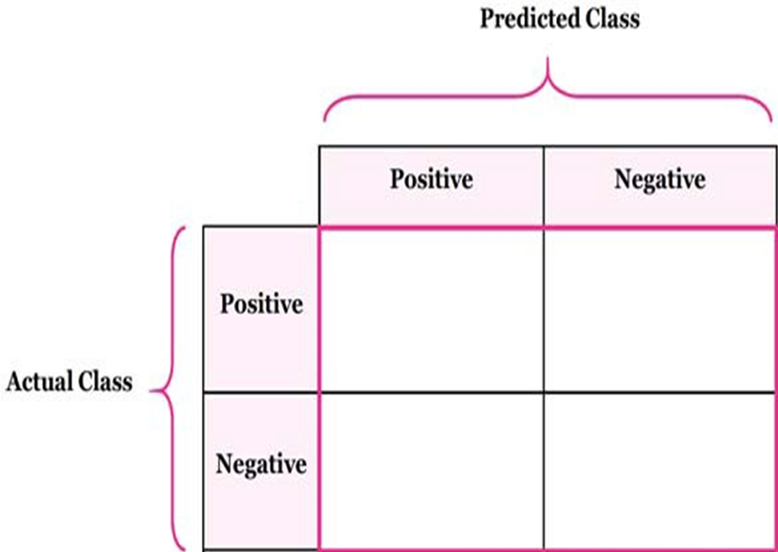
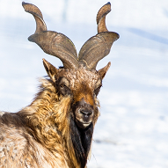
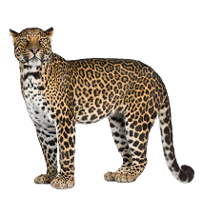
1. Confusion Matrix
True Positive
False Negative:
(Type 1 Error)
False Positive:
(Type 2 Error)
True Negative:
TP
FN
It’s a Markhor
It’s not a Markhor
FP
TN
It’s a Markhor
It’s not a Markhor

Slide 38
1. Confusion Matrix

Slide 39
1. Confusion Matrix (Example)
Actual class\Predicted class | buy_computer (yes) | buy_computer (no) | Total
buy_computer (yes) | 6954 | 46 | 7000
buy_computer (no) | 412 | 2588 | 3000
Total | 7366 | 2634 | 10000
Can you answer these questions:
a) How many computers were bought?
b) What is the value of prediction about the sale of computers?
c) What is the numbers of computers which were actually bought and the algorithm also predicted it correctly?
d) What is the total number of samples in the data?
= 7000
= 7366
= 6954
= 10000

Slide 40
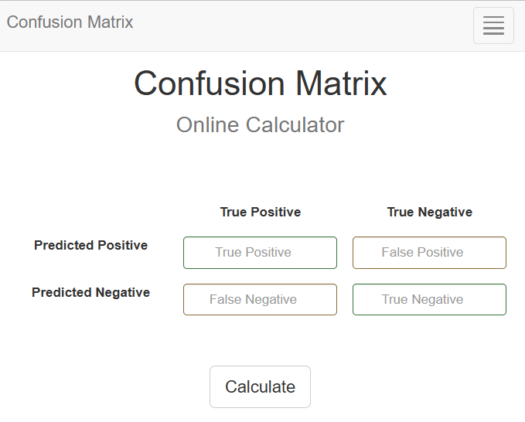
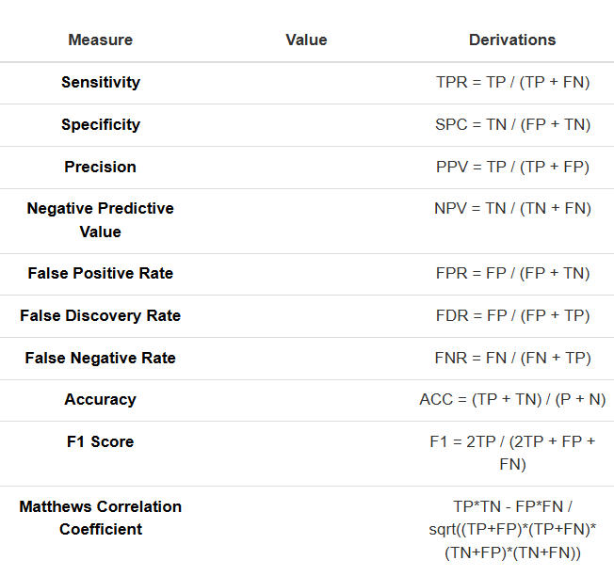
1. Confusion Matrix
Confusion Matrix - Online Calculator Link

Slide 41
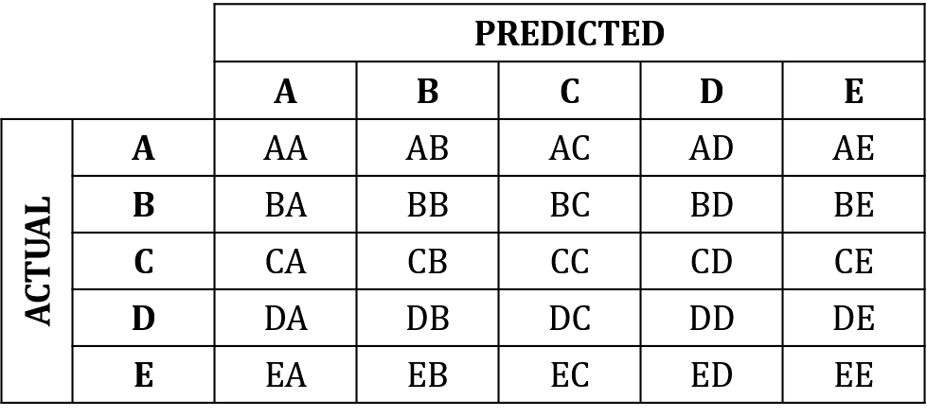
Confusion Matrix for Multiple classes
Let’s assume we have a 5-class problem with the classes A, B, C, D, and E and the following confusion matrix:

Slide 42
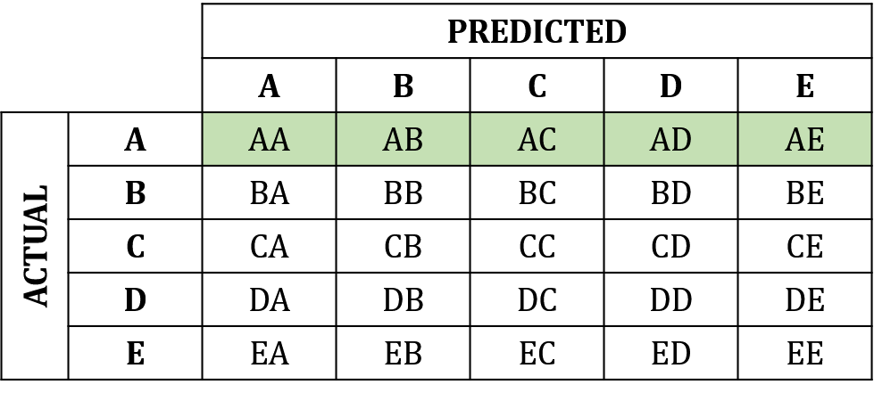
Confusion Matrix for Multiple classes
The Total number of test examples/Samples of any class would be the sum of the corresponding row (i.e. TP+FN for that class).
For example, for class A:

Slide 43
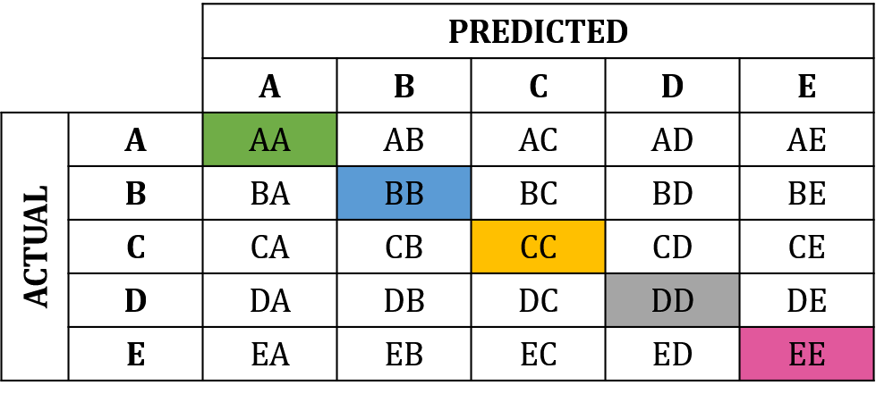
Confusion Matrix for Multiple classes
TP’s is the diagonal value.
For class A: AA
For class B: BB
For class C: CC
For class D: DD
For class E: EE

Slide 44
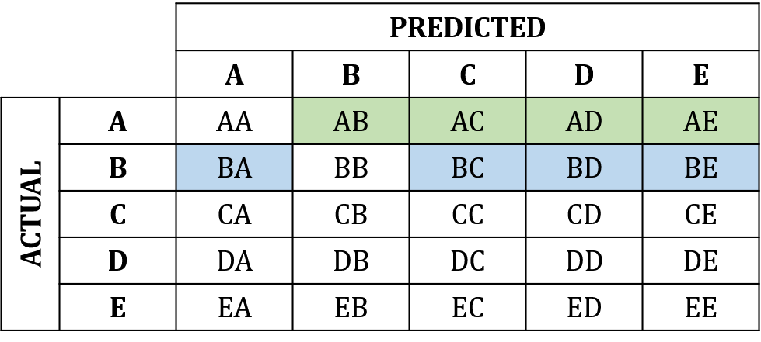
Confusion Matrix for Multiple classes
FN’s is the sum of values in the corresponding row (excluding the TP).
For class A: AB+AC+AD+AE
For class B: BA+BC+BD+BE

Slide 45
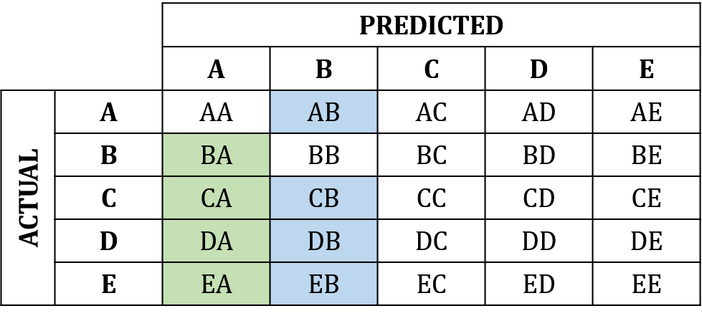
Confusion Matrix for Multiple classes
FP’s is the sum of values in the corresponding column (excluding the TP).
For class A: BA+CA+DA+EA
For class B: AB+CB+DB+EB

Slide 46
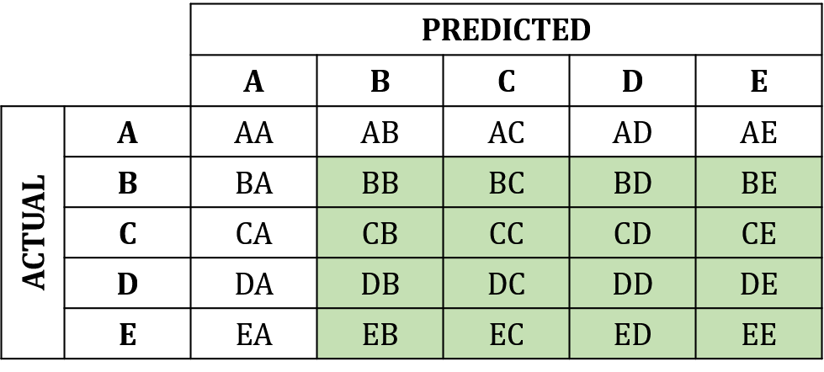
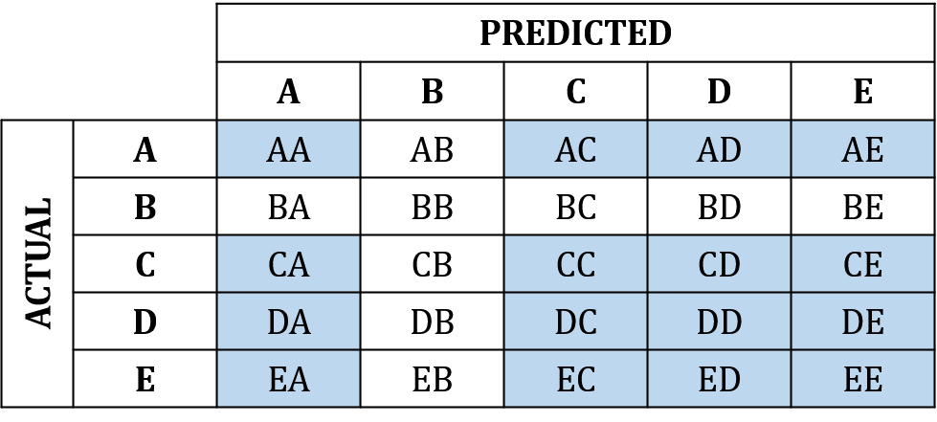
Confusion Matrix for Multiple classes
TN’s is the sum of all columns and rows excluding that class’s column and row.
For class A:
For class B:

Slide 47
Confusion Matrix for Multiple classes

Slide 48
2. Accuracy
The accuracy evaluation metric is one of the simplest and most widely used evaluation measures for the performance of classification models.
Accuracy is the ratio of correctly predicted records/ samples (both positive and negative) to the total number of testing records/ samples.
Range: Accuracy values range from 0 to 1, where:
0 means the model is always wrong.
1 (or 100%) means the model is always correct.
$$Accuracy=\frac{Number of correct predictions}{Total number of predictions}=\frac{(TP+TN)}{(TP+TN+FP+FN)}$$

Slide 49
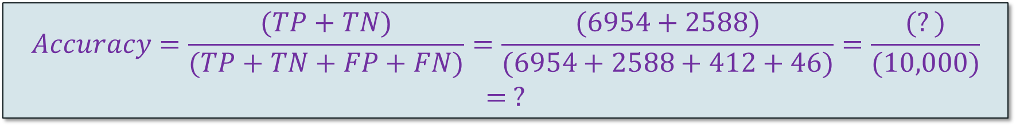
2. Accuracy (Example)
 | buy_computer (yes) | buy_computer (no) | Total
buy_computer (yes) | 6954 | 46 | 7000
buy_computer (no) | 412 | 2588 | 3000
Total | 7366 | 2634 | 10000
$$Accuracy=\frac{(TP+TN)}{(TP+TN+FP+FN)}=\frac{(6954+2588)}{(6954+2588+412+46)}=\frac{(?)}{(10,000)}= ?$$
This algorithm has ___ % accuracy.

Slide 50
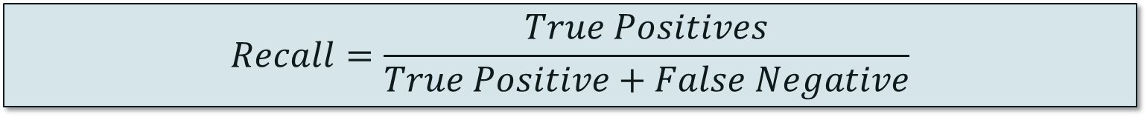
3. Recall
Recall is used to check how well a model finds all the true positive cases in a dataset.
It’s especially useful when the model missing positive cases (like failing to detect a disease) is a bigger problem than having a few extra false positives
Range: Recall values range from 0 to 1, where:
0 means the model missed all the positive cases.
1 (or 100%) means the model correctly found every positive case.
$$Recall=\frac{True Positives}{True Positive+False Negative}$$

Slide 51
3. Recall
 | buy_computer (yes) | buy_computer (no) | Total
buy_computer (yes) | 6954 | 46 | 7000
buy_computer (no) | 412 | 2588 | 3000
Total | 7366 | 2634 | 10000
$$recall=\frac{(TP)}{(TP+FN)}=\frac{(6954)}{(6954+46)}=\frac{(6954)}{(7000)}= ?$$
This algorithm has ___ % recall.
Recall is valuable when the dataset is imbalanced.
In such cases, accuracy can be misleading, but recall focuses on finding all positive samples.

Slide 52
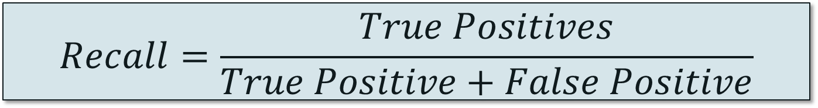
4. Precision
It shows how accurate the positive predictions of a model are.
It is useful when more important to avoid false positives (wrongly marking something as positive) than it is to find every positive case.
Range: Precision values range from 0 to 1, where:
0 means that all positive predictions are incorrect.
1 (or 100%) means that all positive predictions are correct.
$$Recall=\frac{True Positives}{True Positive+False Positive}$$

Slide 53
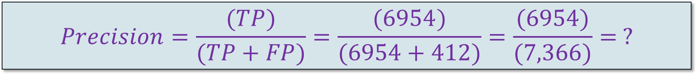
4. Precision
 | buy_computer (yes) | buy_computer (no) | Total
buy_computer (yes) | 6954 | 46 | 7000
buy_computer (no) | 412 | 2588 | 3000
Total | 7366 | 2634 | 10000
$$Precision=\frac{(TP)}{(TP+FP)}=\frac{(6954)}{(6954+412)}=\frac{(6954)}{(7,366)}= ?$$
This algorithm has ___ % precision.
Recall is valuable when the dataset is imbalanced.
In such cases, accuracy can be misleading, but recall focuses on finding all positive samples.

Slide 54
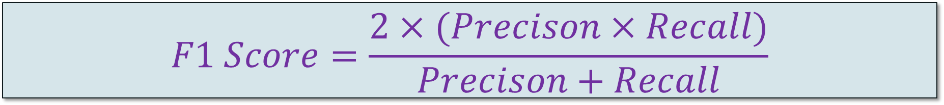
5. F1-Score
The F1 Score is the harmonic mean of Precision and Recall.
Range: The F1-Score ranges from 0 to 1, where:
0 means either precision or recall is zero (perform poorly).
1 means both precision and recall are perfect (perform very well).
$$F1 Score=\frac{2×(Precison×Recall)}{Precison+Recall}$$

Slide 55
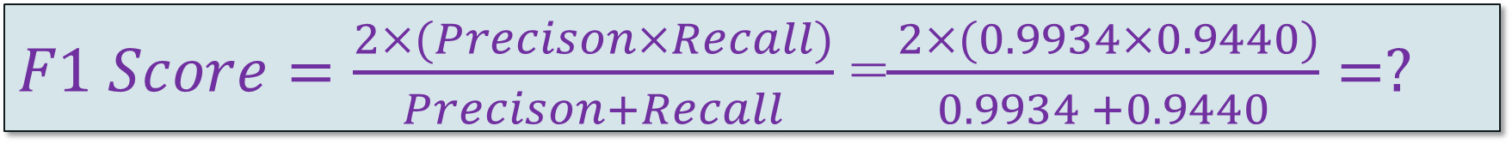
5. F1-Score
 | buy_computer (yes) | buy_computer (no) | Total
buy_computer (yes) | 6954 | 46 | 7000
buy_computer (no) | 412 | 2588 | 3000
Total | 7366 | 2634 | 10000
$F1 Score=\frac{2×(Precison×Recall)}{Precison+Recall}$ =$\frac{ 2×(0.9934×0.9440)}{0.9934 +0.9440}=?$
This algorithm has ___ F1-Score.

Slide 56
6. ROC Curve
It is the Receive Operating Characteristics curve.
It is a plot of the True Positive Rate (TPR) against the False Positive Rate (FPR).
True positive rate:
False positive rate (or Fallout):

Slide 57
6. ROC Explain
Go for the perfect classifier

Slide 58
6. ROC Example
Questions:
Which classifier is good for the value 0.2
Which one is good for the value of 0.42
Which one performs well for the value of 0.8
Which one you select?

Slide 59
7. Mean Absolute Error (MAE)
Absolute Error is the amount of Error in a measurement

Slide 60
8. Mean Square Error (MSE)
Another standard performance evaluation measure

Slide 61
9. Root Mean Square Error (RMSE)
Or Standard Deviation of the predicted Error

Slide 62
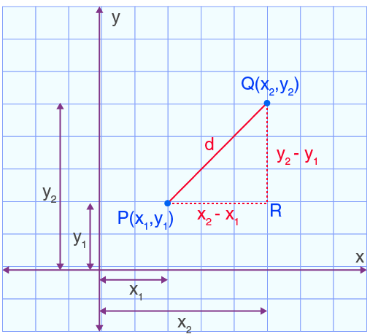
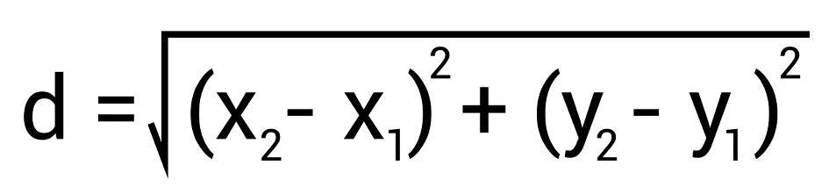
10. Euclidean Distance
It is one of the most commonly used measures to calculate the straight-line distance between two points
Formula
P(2, 3) :
x1=2, y1=3
Q(6, 8):
x2=6, y2=8

Slide 63
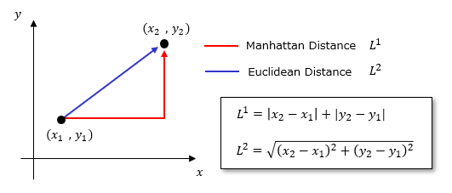
11. Manhattan Distance
It is also known as L1 norm or taxicab distance. It represents the path you would take if you could only move horizontally or vertically.
Formula

Slide 64
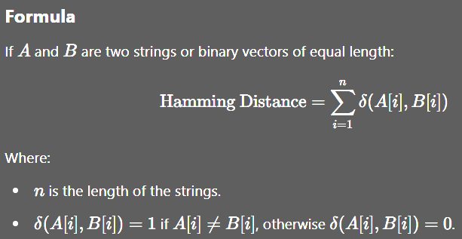
12. Hamming Distance
Hamming Distance is a metric used to measure the difference between two strings of equal length. It calculates the positions at which the corresponding symbols (characters or bits) differ.

Slide 65
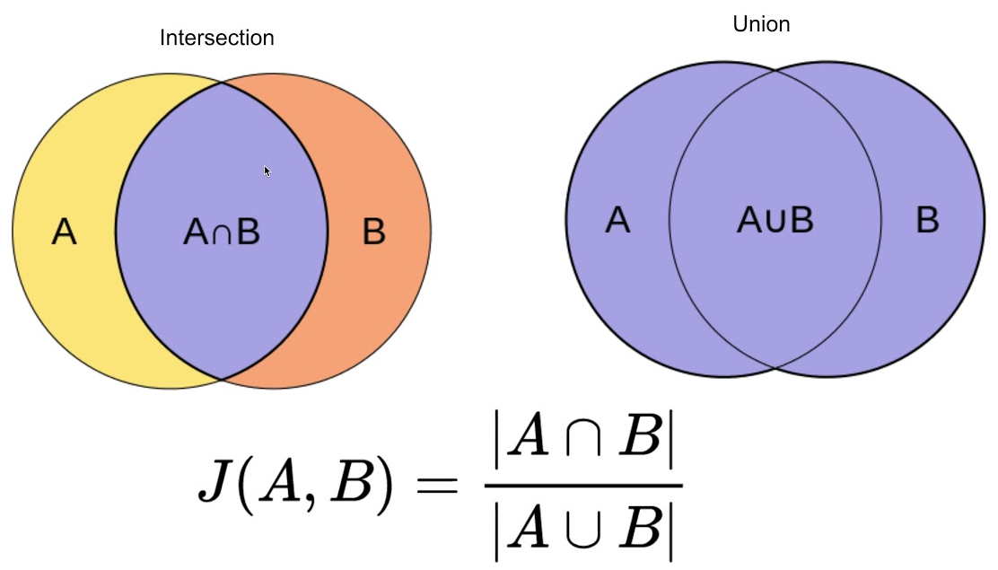
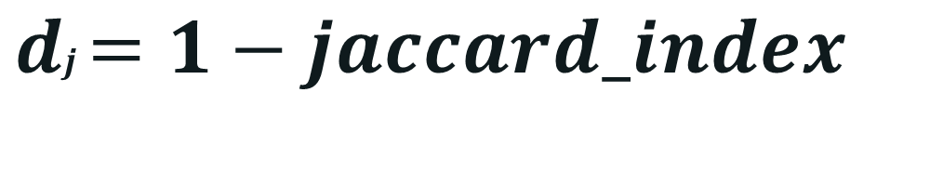
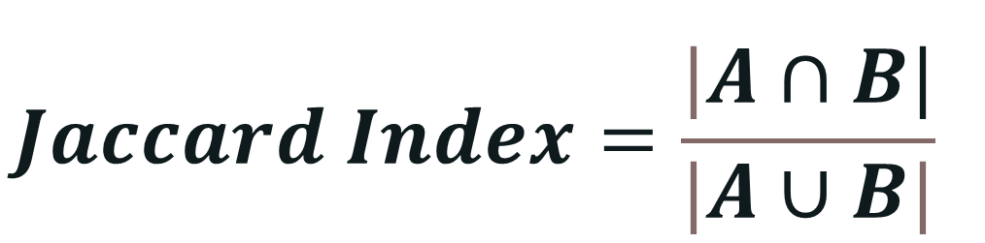
13. Jaccard Distance
It is a metric that measures the dissimilarity between two sets. It is derived from the Jaccard Index, which is a calculation between two sets by comparing the size of their intersection to the size of their union
$$\begin{matrix} \\ Jaccard Index=\frac{|A∩B|}{|A∪B|}\end{matrix}$$
$$\begin{matrix}dj=1−jaccard_index \\ \end{matrix}$$

Slide 66
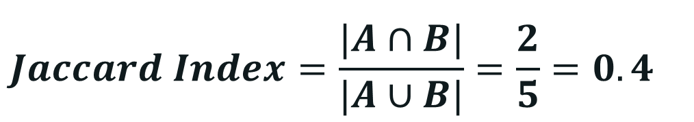
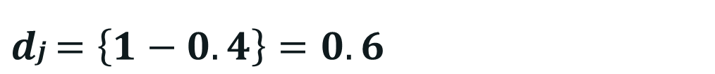
Example of Jaccard Distance
Set A: {apple, banana, cherry}
Set B: {banana, cherry, date, berry}
Solution:
Intersection (A ∩ B): {banana, cherry} |A ∩ B|: 2
Union (A ∪ B): {apple, banana, cherry, date, elderberry}, |A ∪ B|: 5
$$\begin{matrix} \\ Jaccard Index=\frac{|A∩B|}{|A∪B|}=\frac{2}{5}=0.4\end{matrix}$$
$$\begin{matrix} \\ dj=\left\{1−0.4\right\}=0.6\end{matrix}$$

Slide 67
Over Fitting & Under Fitting

Slide 68
Over Fitting
Overfitting occurs when a model learns not only the patterns in the training data but also the noise and outliers. As a result, the model performs very well on the training data but poorly on new, unseen data.
Symptoms of Overfitting:
  Very high accuracy on the training data.
  Poor performance on the test or validation data.
  The model is too complex, having too many parameters/features
How to avoid overfitting:
  Use simpler models: Reduce the complexity (e.g., fewer features, simpler algorithms).
  Cross-validation: Use techniques like K-fold cross-validation.
  More training data: More data can help the model learn general patterns instead of noise

Slide 69
Underfitting
Underfitting occurs when a model is too simple to capture the patterns of the data. The model will perform poorly on both the training data and new, unseen data because it hasn’t learned enough from the training set.
Symptoms of Underfitting:
  Low accuracy on both training and test data.
  The model is too simplistic or too constrained.
How to avoid underfitting:
  Increase model complexity: Use more complex models or add more features.
  Remove overly simplistic assumptions: Ensure the model is capable of capturing the relationships in the data.
  Allow more training: Let the model train for more epochs or iterations (e.g., for neural networks).

Slide 70
Python ipynb code
Example python repo: https://github.com/Mubshr07/ArtificialIntelligence-HITEC-Fall2025
Make your GitHub account
give a star to this repo

Slide 71

Recap
Data Splitting
Introduction to ML (ML):
  • Types of ML: Supervised, Unsupervised, Reinforcement Learning
  • Regression (Linear and Logistic)
  • Classification Techniques
  • Model Evaluation Metrics (Accuracy, Precision, Recall, F1-Score)
  • Hyperparameter Tuning and Overfitting

